Slide 1
Cab Booking Application
By: -
Akash (46001179)
Aman (46001780)
Anchita (46002265)
Shubham (46002223)
Surjani (46001701)
Vineeta (46004887)
Vishal (46001972)

Slide 2
Cab Booking Application is created to meet the needs of the online cab booking application with the customer being able to:
Login:
Into the application using his/her credentials.
Sign up:
By entering valid details.
Book a cab:
By entering source, destination and vehicle model.
View:
Past rides.
Send feedback:
For past trips.

Slide 3
Driver will be able to:
Login:
Into the application using his/her credentials.
Sign up:
By entering valid details.
View:
Past rides.
Admin will be able to:
Login:
Into the application using his/her credentials.
Verify:
The details of the driver while registration.
View:
Past rides.
Handle:
Customer Issues.

Slide 4
Technology Used:
Java 8(base programming language)
Jdk1.8.0_65
Jre1.8.0_65
Log4j-api-2.11.2.jar
Junit 4.12
Spring Web 5.1.10.RELEASE
Spring Boot 2.1.9
Spring Data 2.1.9
My SQL 5.5.43(database storage)
GIT 2.23.0(DevOps VCS tool)
Maven 4.0.0(DevOps tool- Build & manage project)
Postman 7.11.0(for running RESTful service)
Node JS 10.16.2(Javascript Runtime Environment)
Angular CLI 6.2.9(Framework to develop web apps)

Slide 5
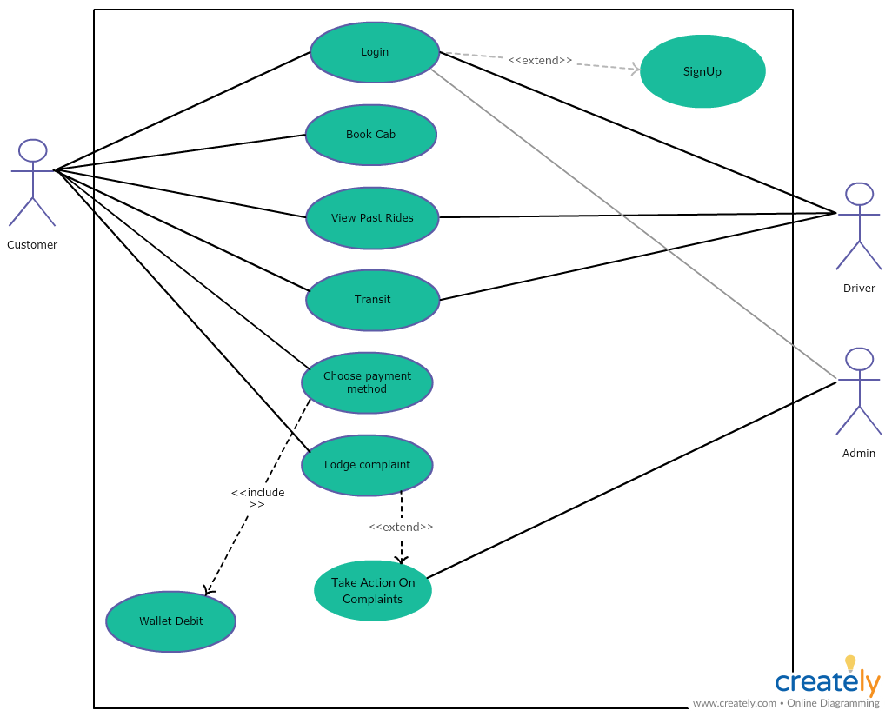
Use Case Diagram

Slide 6
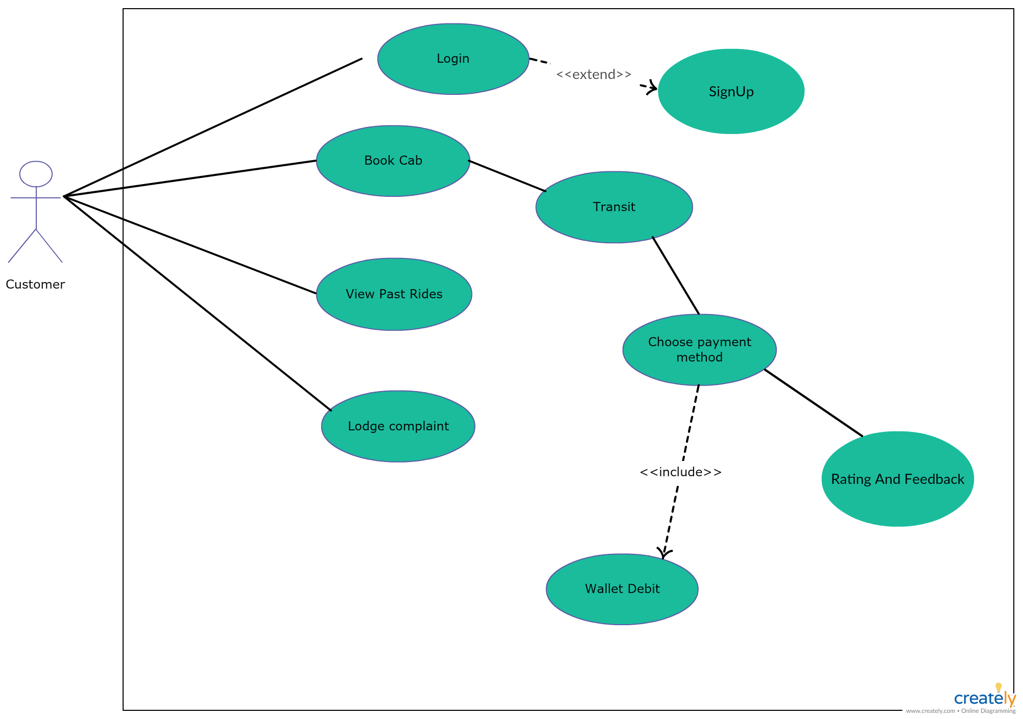
Use Case Diagram
(CUSTOMER)

Slide 7
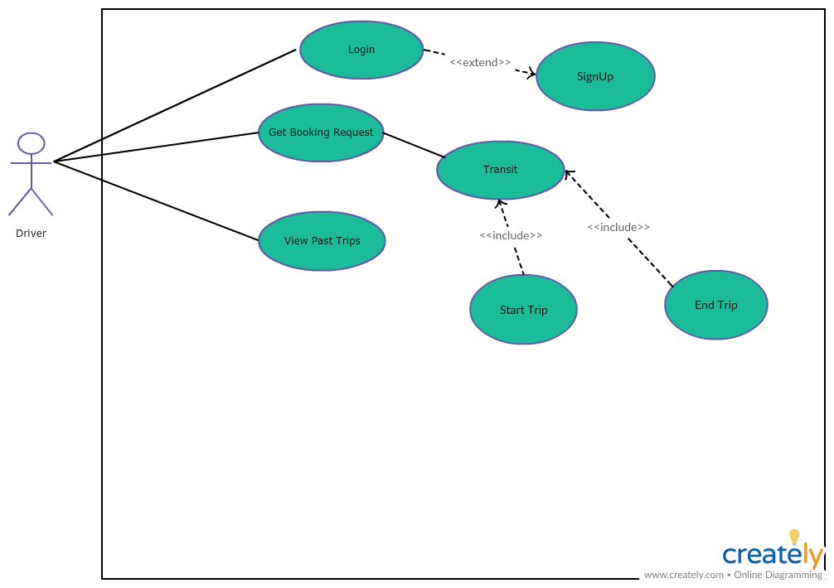
Use Case Diagram
(DRIVER)

Slide 8
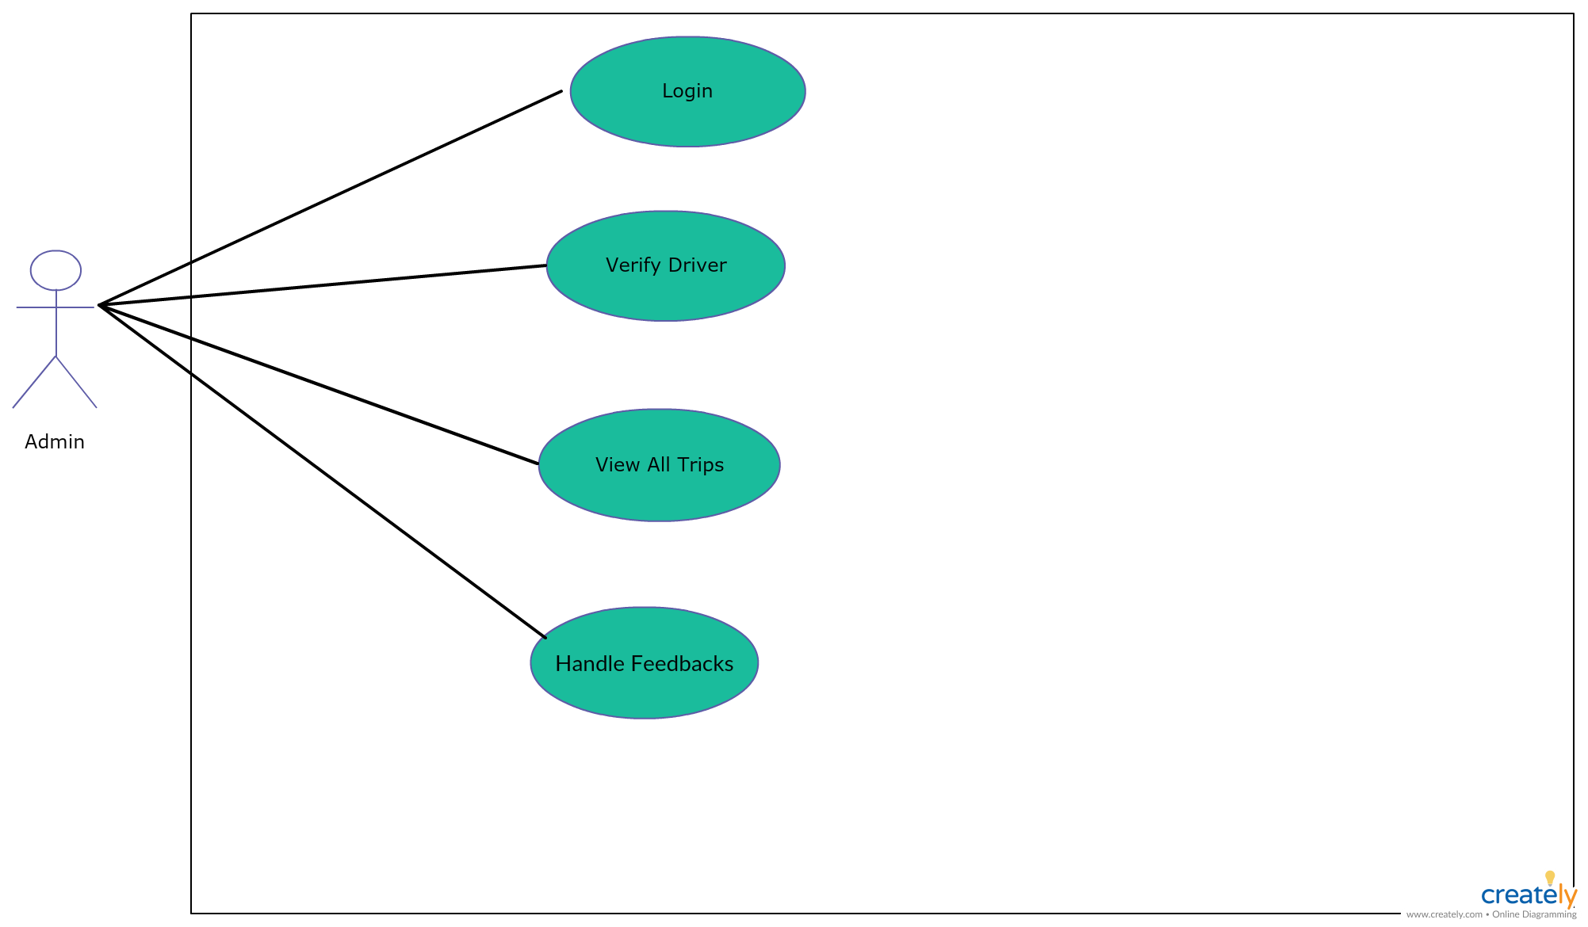
Use Case Diagram
(ADMIN)

Slide 9
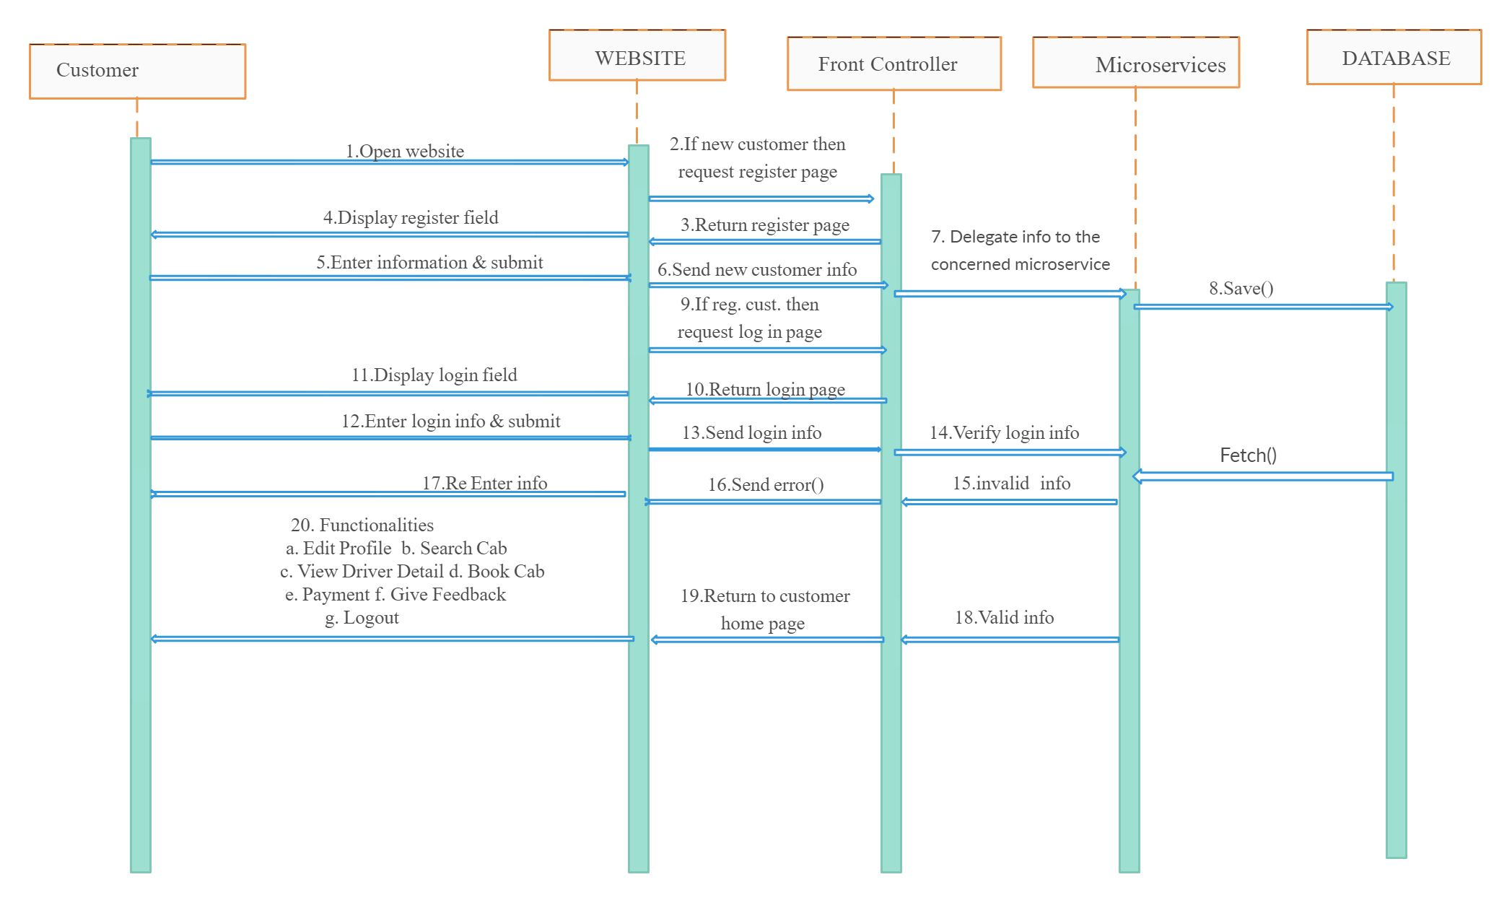
Sequence Diagram
(Customer)

Slide 10
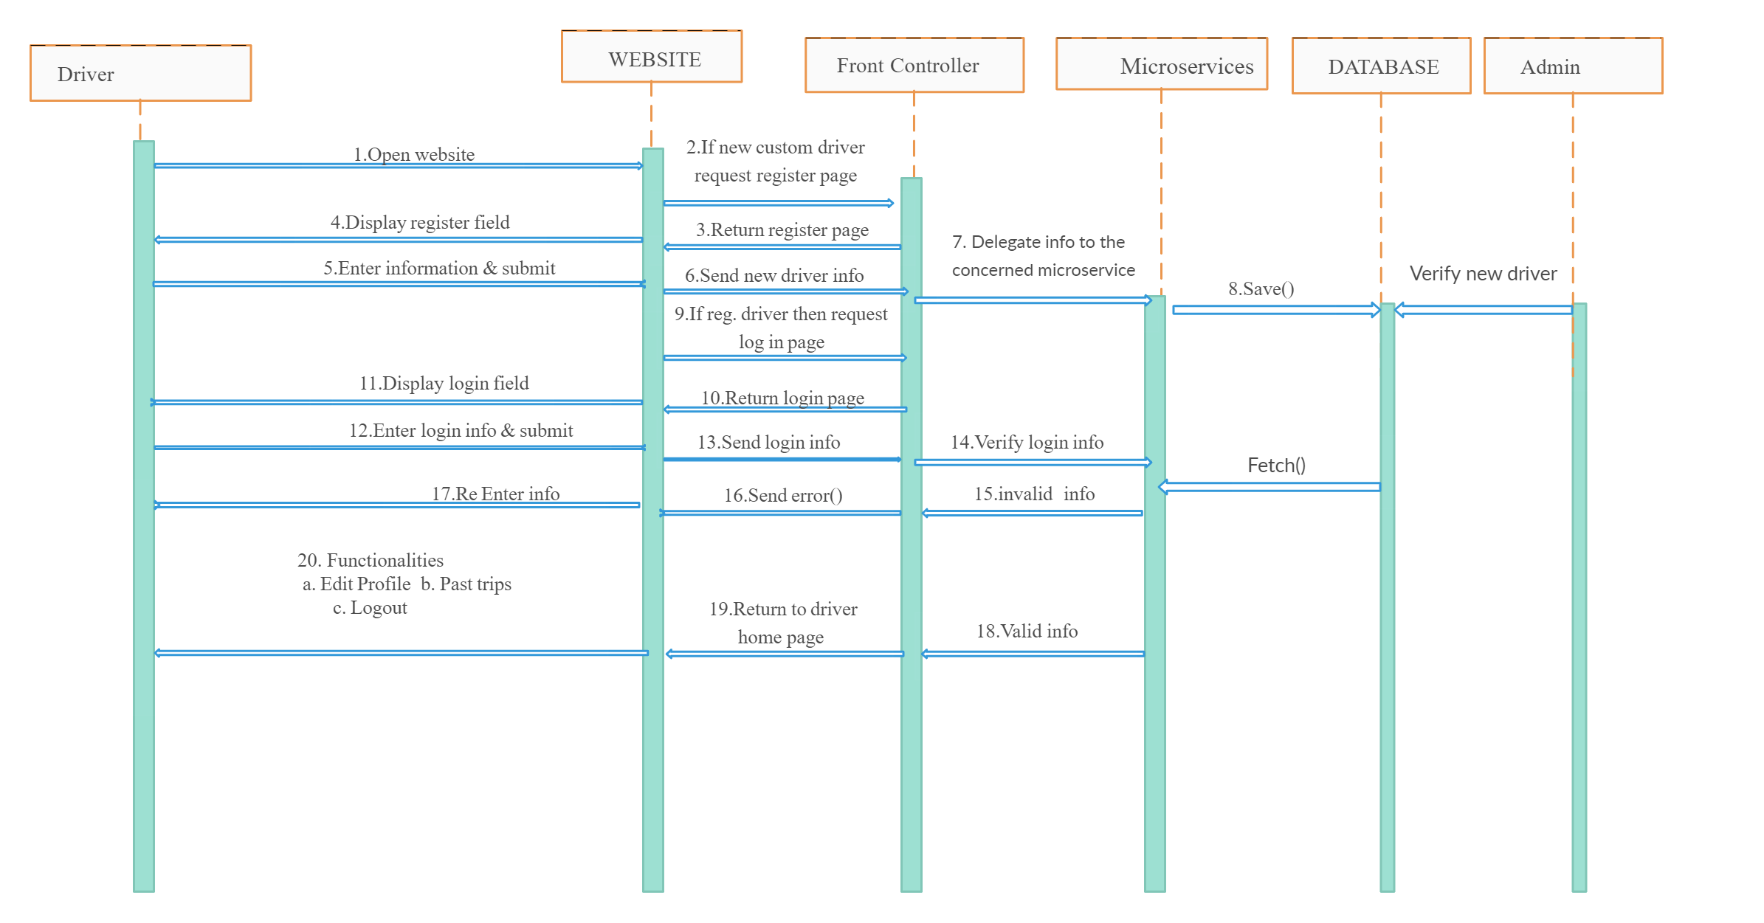
Sequence Diagram
(Driver)

Slide 11
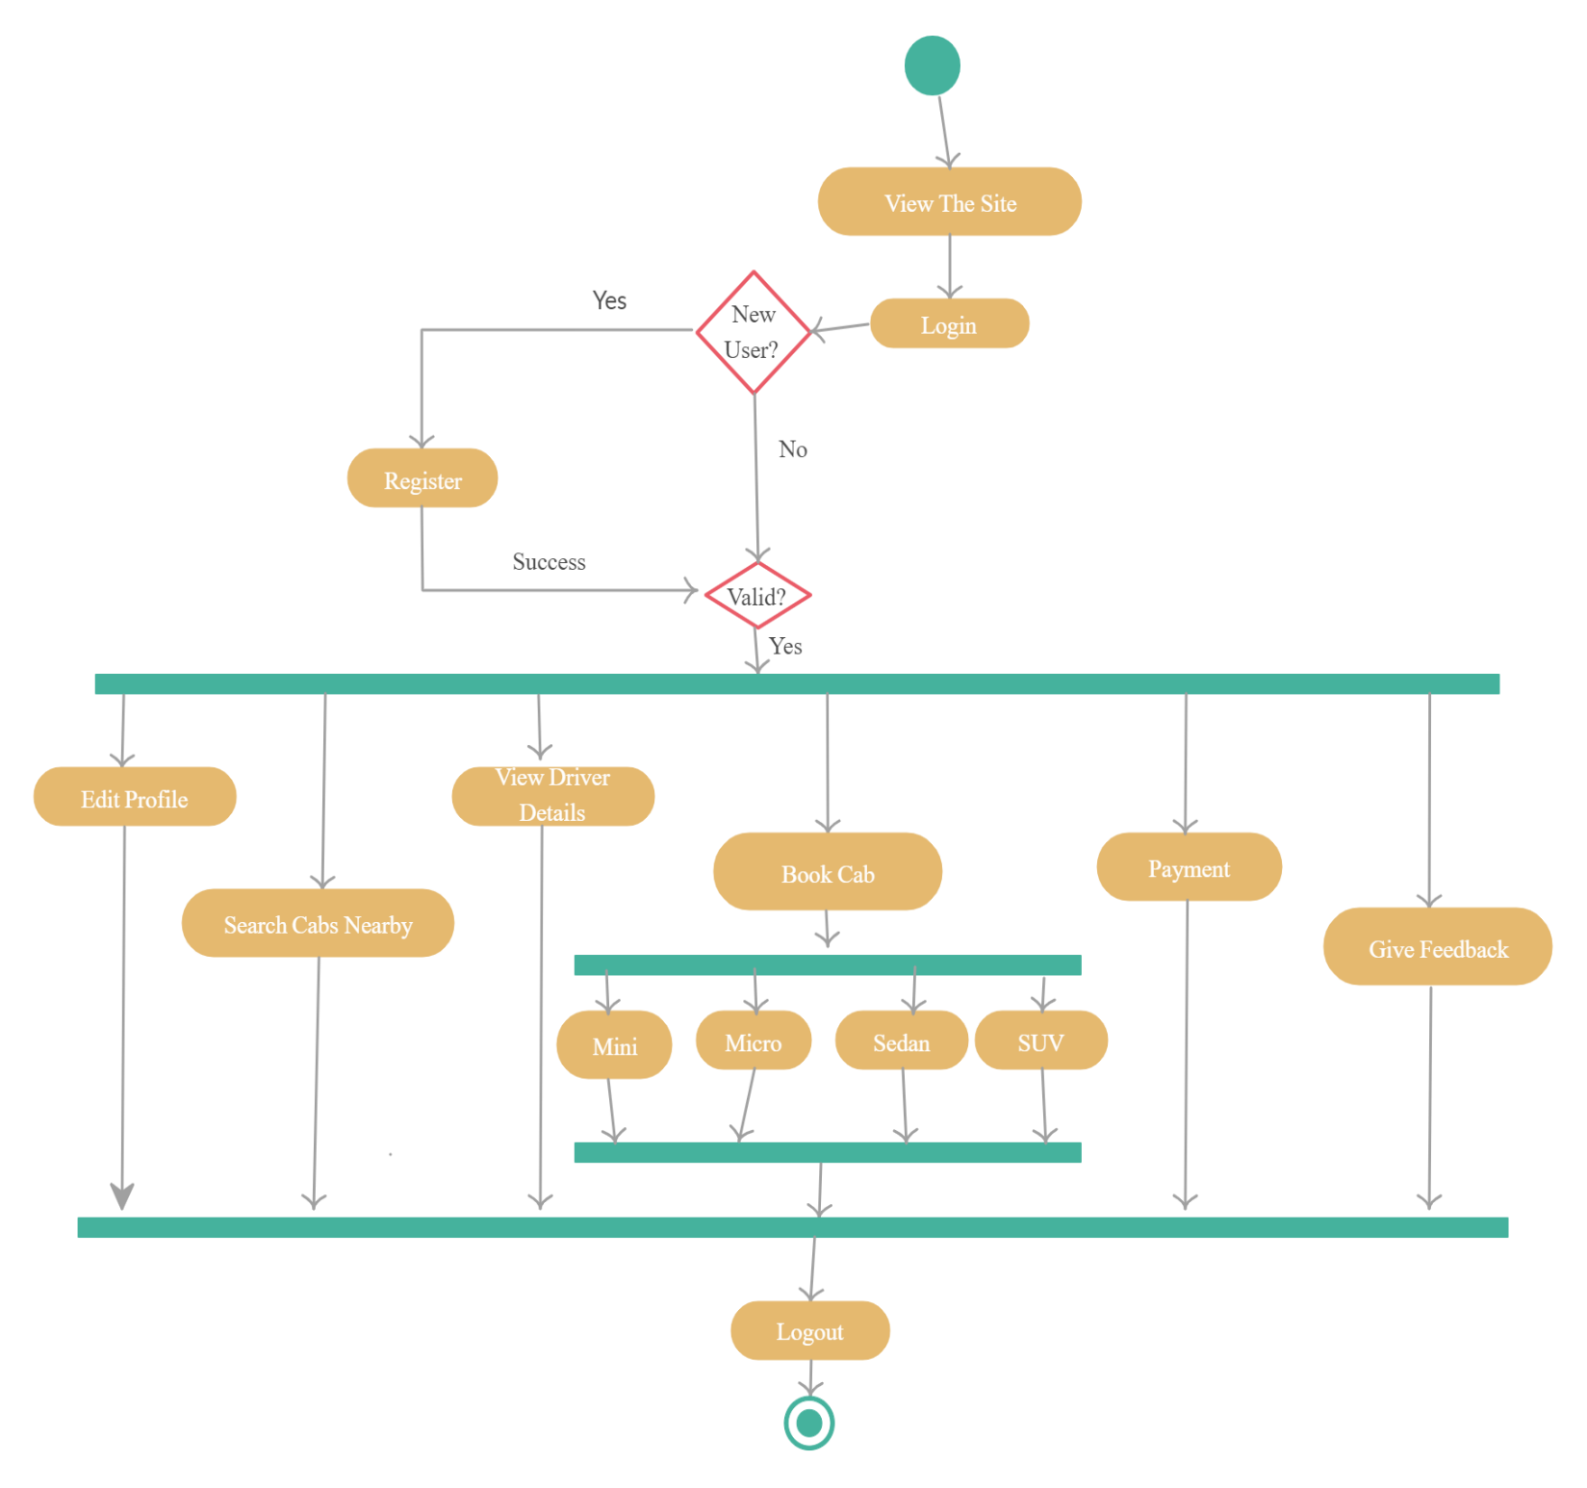
Activity Diagram
(Customer)

Slide 12
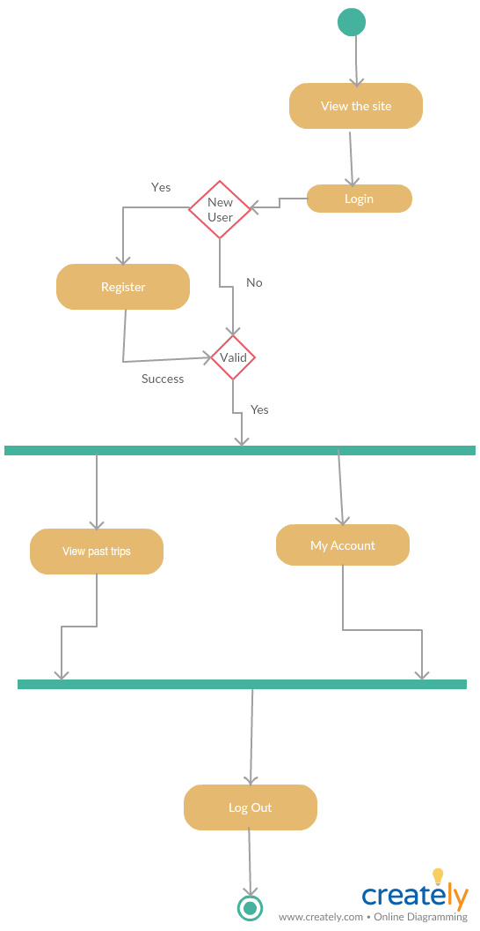
Activity Diagram
(Driver)

Slide 13
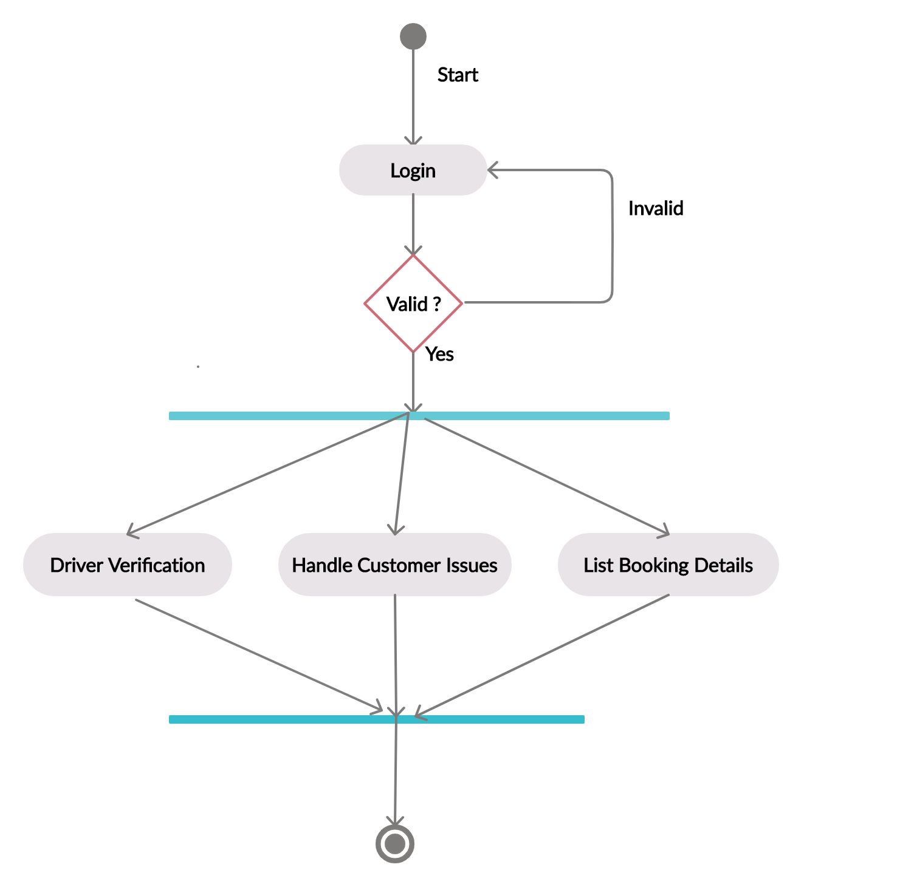
Activity Diagram
(Admin)

Slide 14
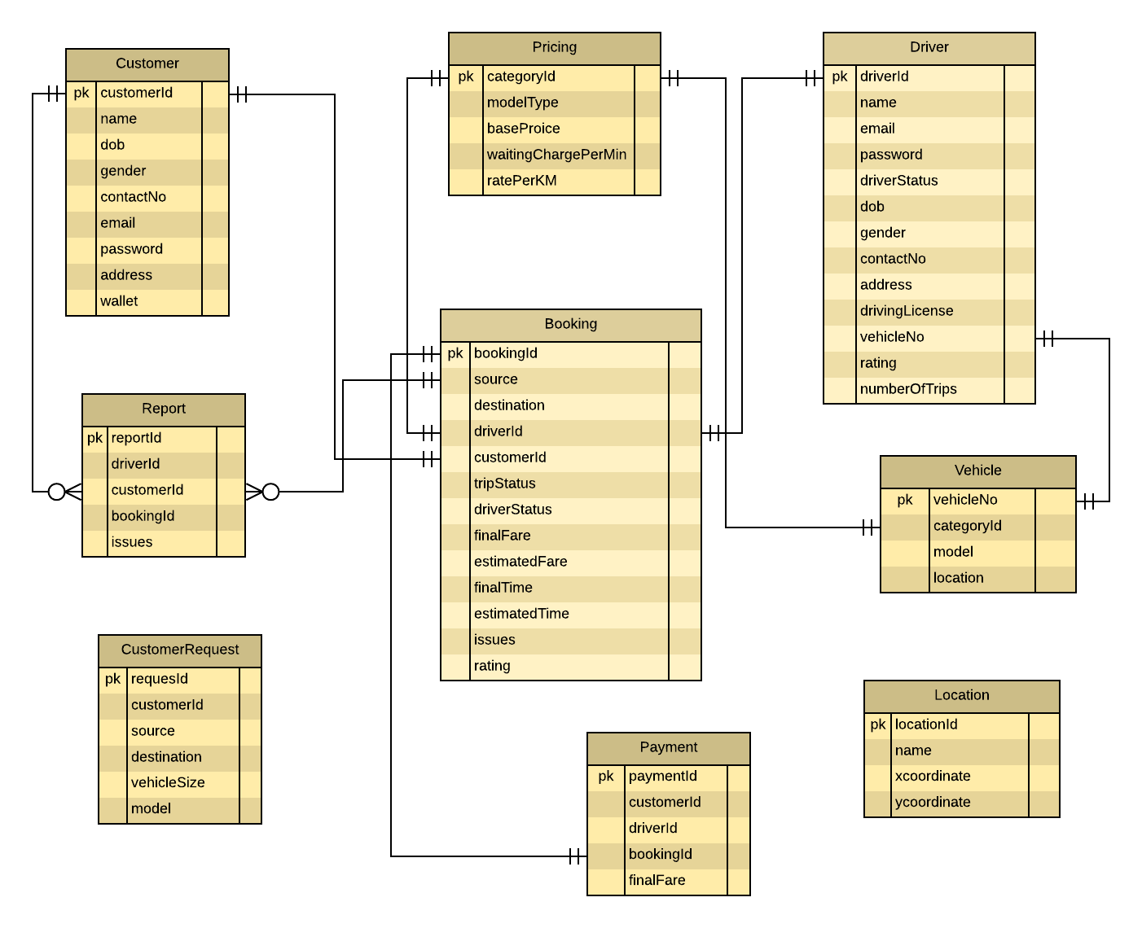
ER Diagram

Slide 15
Modules:
Admin
Payment/Feedback
Trip Selector
Login/
SignUp
Transit
Cab Allocation
(Customer Side)
Cab Allocation
(Driver Side)

Slide 16
Section break

